Slide 1

Hohmann orbit transfer analysis
Explore the space beyond your imagination

Slide 2
Orbit transfer methods
There are total 4 kind of methods to change your probes method.
1st . Hohmann transfer orbit
2nd . Bi elliptical transfer
3rd . Geostationary transfer orbit
4th . Lunar transfer orbit

Slide 3
Hohmann transfer
The coplanar circular orbit-to-circular orbit transfer was discovered by the German engineer Walter Hohmann in 1925 and described in his classic report. The transfer consists of a velocity impulse on an initial circular orbit, in the direction of motion and collinear with the velocity vector, which propels the space vehicle into an elliptical transfer orbit. At a transfer angle of 180 degrees from the first impulse, a second velocity impulse or Delta V , also collinear and in the direction of motion, places the vehicle into a final circular orbit at the desired final altitude. The impulsive Delta V assumption means that the velocity, but not the position, of the vehicle is changed instantaneously. This is equivalent to a rocket engine with infinite thrust magnitude. The Hohmann formulation is the ideal and minimum energy solution to this type of time-free orbit transfer problem.

Slide 4
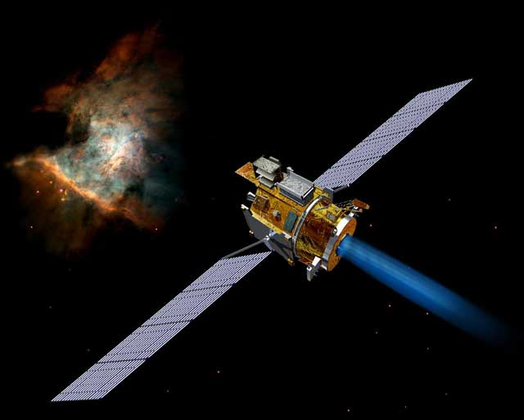
Process
The thing which is probe or may be telescope or other thing is first placed at stationary circular orbit with the help of any rocket .

Slide 5
After moving in circular orbit at a pre defined point there is a little amount of thrust is provided at collinear direction of motion .
After giving the thrust of some amount the probe is changing its orbit from circular to elliptical orbit.
The point at which the first thrust is given that point is called as apogee.

Slide 6
After entering in a elliptical orbit at the largest distance from centre of earth the second thrust is provided to change orbit.
The orbit is changed successfully , with the help of this method ,we can transfer orbit as we wanted.

Slide 7
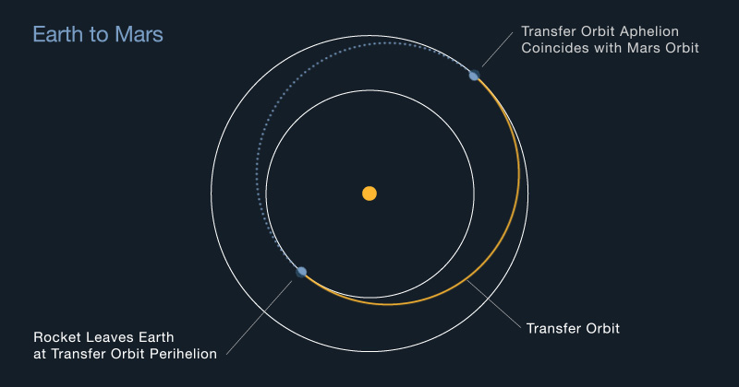
Graphical representation

Slide 8
